Slide 1
Northeast AQ Management Challenges
Ozone
NOx
VOCs
Wind
PM2.5/aerosols/haze

Slide 2
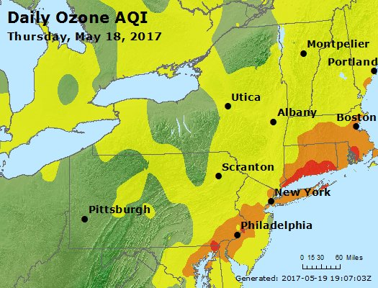
Chronic regional ground-level ozone (smog) problem
Multiple pollution transport pathways affecting area
Complicated, varied, and dense pollution source region
Land-water interactions downwind of NYC
AIRNow
Source: AirNOW

Slide 3
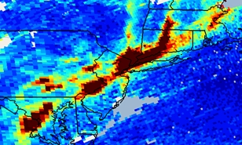
TropOMI NO₂ in Winter Northeast Feb. 2-4, 2019 Haze Event
Feb. 4, 2019 TropOMI NO₂ image from Michael Geigert, CT DEEP

